Slide 1

Sales Performance Dashboard “Real-Time Analysis of Key Business Metrics Using VBA”
Presented by -
Lasvitha Pregada
Sadanand
Sneha Venkatapathy

Slide 2
Project Description
Develop a real-time Sales Performance Dashboard using VBA.
Integrate inventory optimization with sales and profit monitoring capabilities.
Provide a user-friendly interface for stakeholders to interact with business data.
Automate calculations for profit, revenue, returns, and inventory metrics.
Enable dynamic sensitivity analysis through interactive charts and visualizations.
Use Adventure Works Sales Data 2022 for data-driven insights and projections.

Slide 3
Project Objectives
Create a VBA-powered tool for seamless data extraction and analysis.
Automate repetitive tasks, including profit margin and revenue calculations.
Design an intuitive interface for client-driven analysis and reports.
Generate dynamic visualizations to highlight key performance indicators (KPIs).
Optimize inventory management and logistic comparisons through scenario simulations.
Enhance decision-making by delivering actionable insights with minimal manual effort.

Slide 4

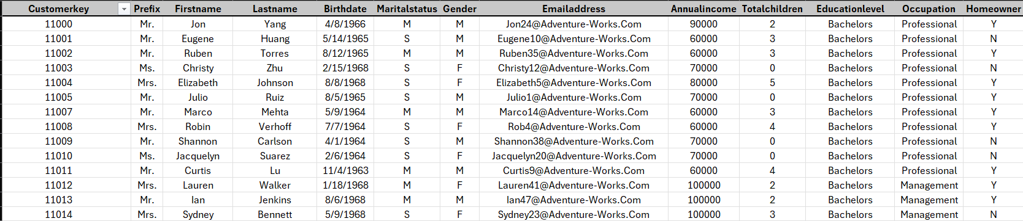
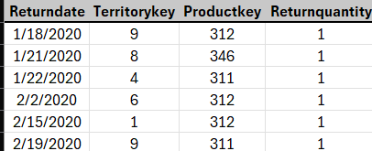
Dataset Description
Adventure Works Sales Data 2022.
Includes 7 worksheets containing data on:
Sales
Returns
Products
Customers
Timeline
Product Categories
Sub Categories
Customer Lookup data
Returns data

Slide 5
Key VBA Features Implemented
Simplified repetitive operations like data entry, dataset imports, and calculations using VBA Object Model.
Organized and processed data ranges effectively with Range Objects and Built-in Functions.
Utilized loops and flow controls for data extraction, cost estimation, and scenario simulations.
Built reusable Sub Procedures and Function Procedures for tasks like cost and sales management.
Triggered automatic recalculations through Event Procedures when data inputs changed.
Created dynamic charts for sales and profit analysis, product performance, and financial forecasting.
Designed Dialog Boxes and User Forms for seamless data input, scenario selection, and result display.

Slide 6
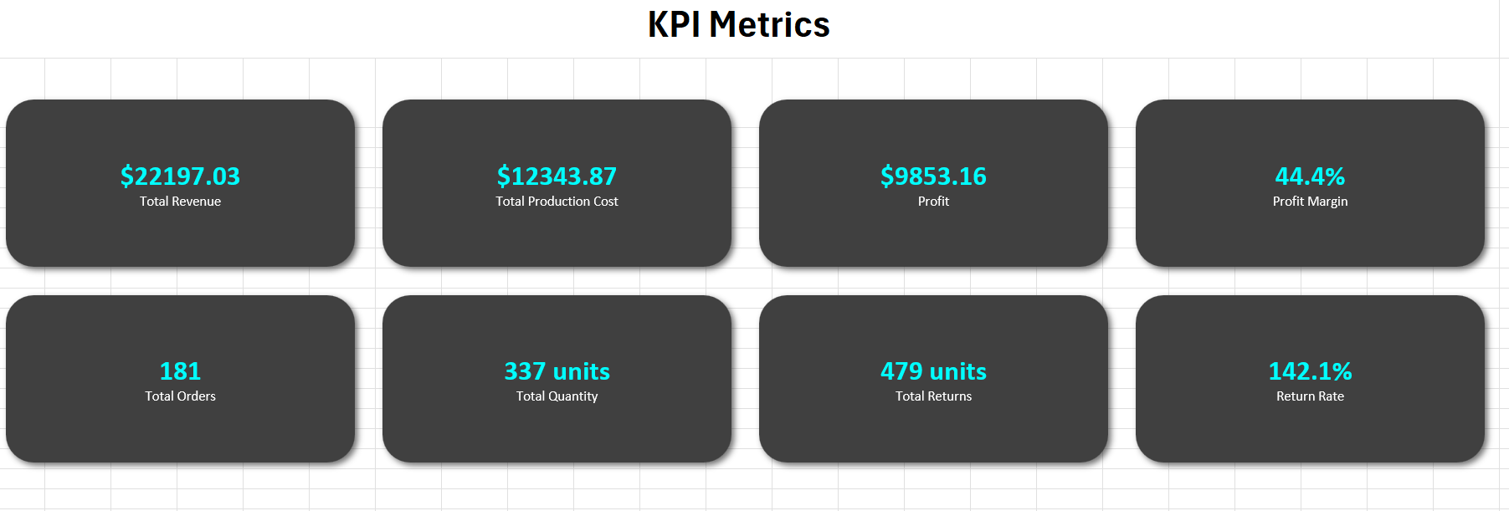
Key Performance Indicators
Key Performance Indicators identified for the company for the year 2022 using VBA Macros is as follows:

Slide 7
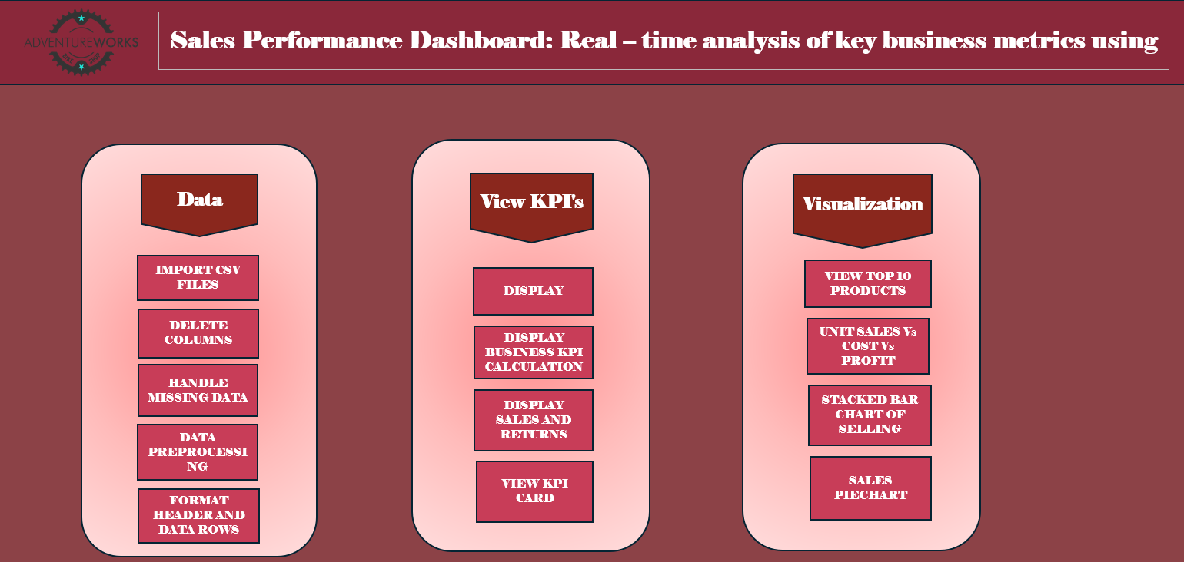
Dashboard snippet

Slide 8
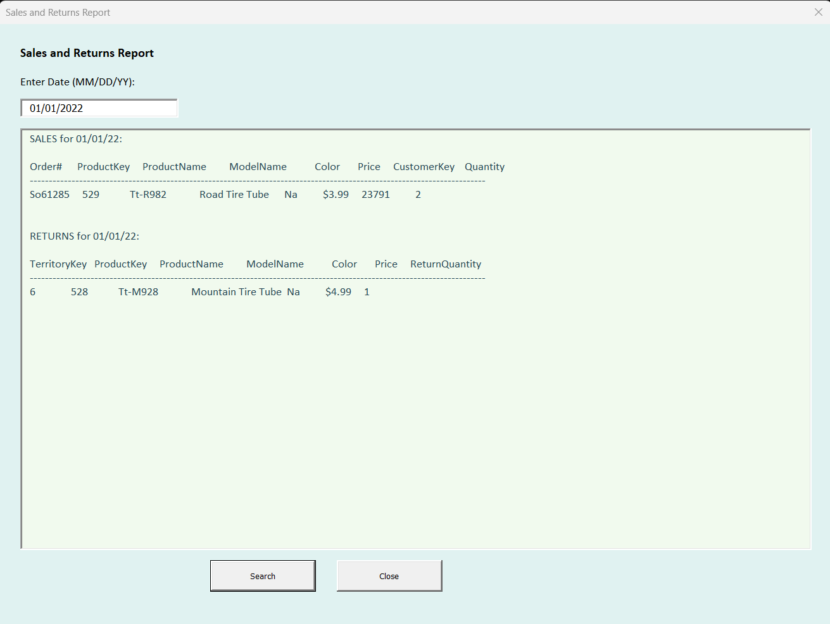
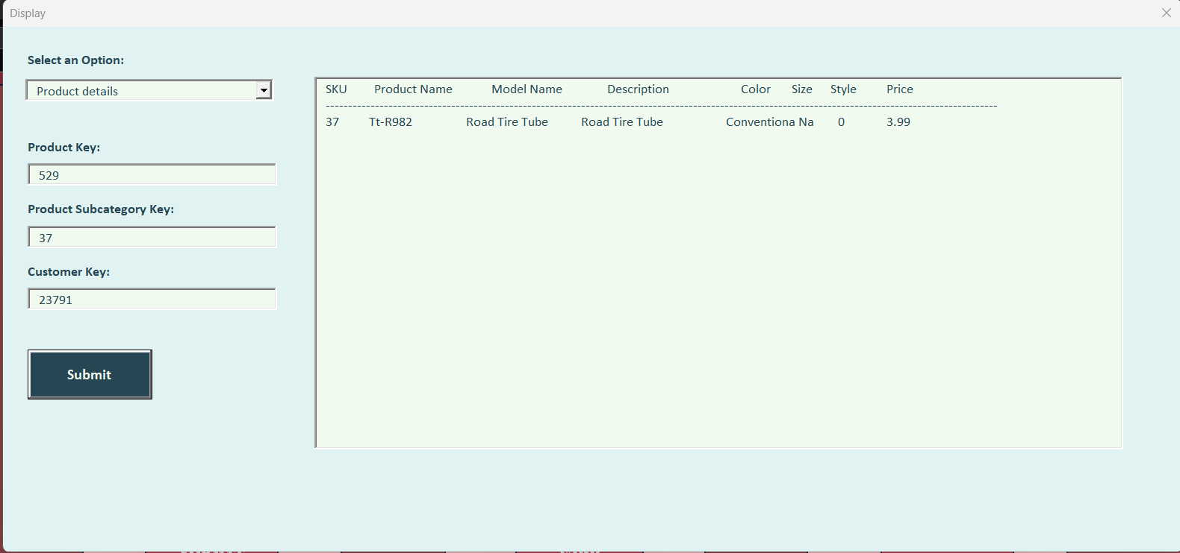
Userforms for Lookup

Slide 9
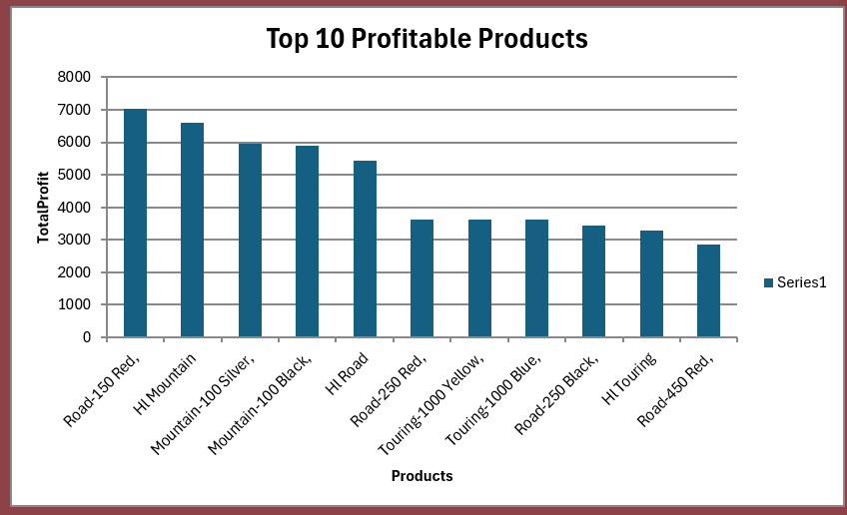
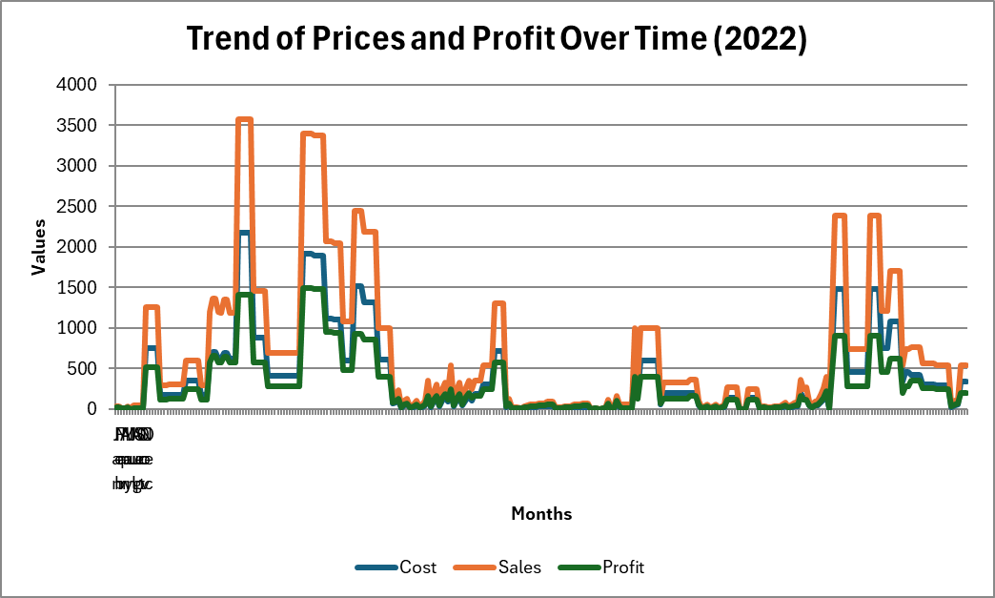
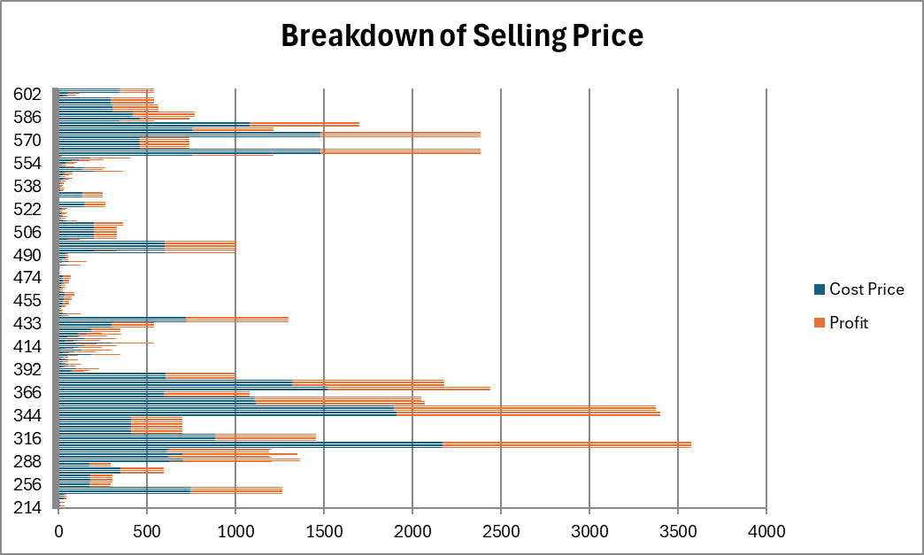
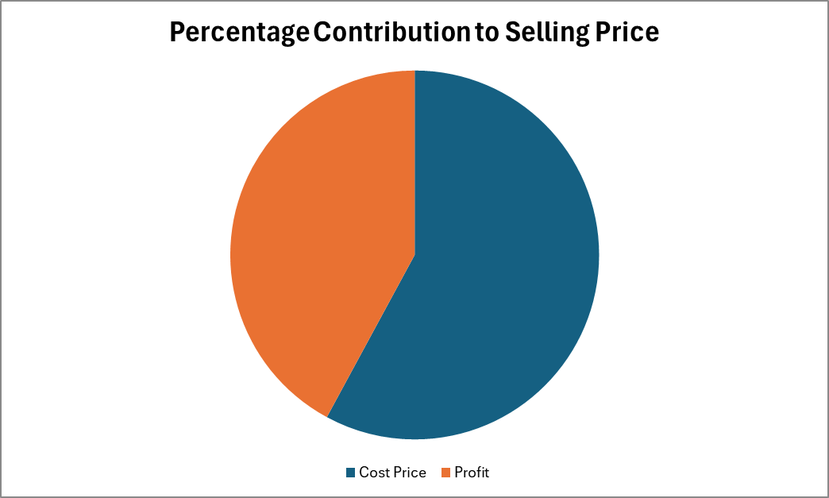
Data Visualizations

Slide 10
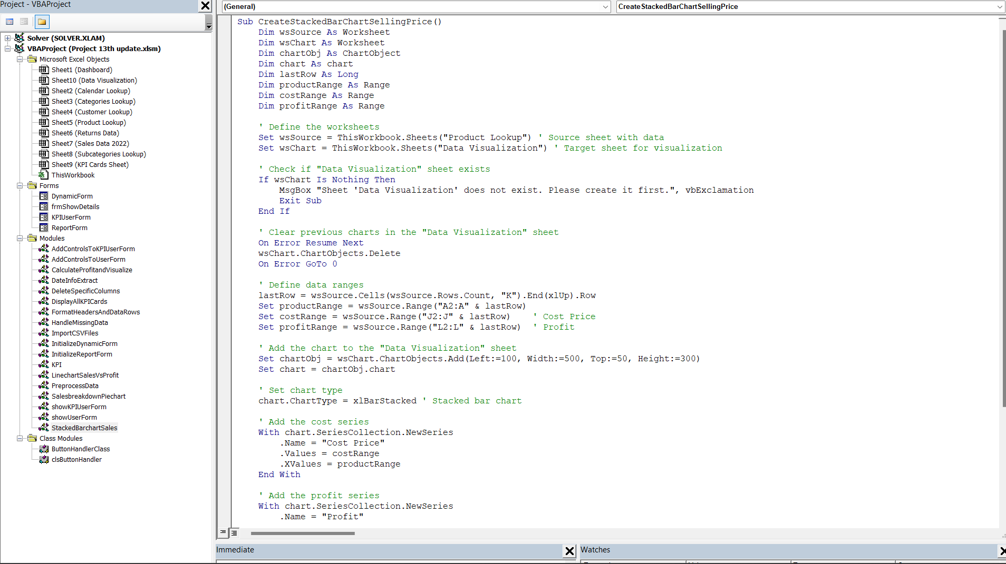
Project code & Implementation Walkthrough !

